Slide 1








Slide 2

At Mason Moor, we serve a community of predominantly White British families – one where diversity is beginning to grow but where social attitudes are not yet as advanced.
We understand that a lack of cultural appreciation leads to xenophobia. Teaching Black history enables our pupils to become culturally responsive. We must remind children that black history IS British history! Our philosophy for teaching centres around our values:
NURTURE – GROW – ACHIEVE
Black History is a curriculum drop-down week which informs, educates, celebrates and remembers. We will use a wealth of resources including: visual, art, spoken word (including music), video, real-life speakers and visits.
The week will culminate in each child contributing to a ‘bigger piece’ school project. Simultaneously the project will support the retention of new knowledge in relation to: famous Black Britons, shared stories, racism and the Black Lives Matter movement and Black History.
But it doesn’t end here. Our wider curriculum now incorporates greater texts by Black authors across year groups. Our History curriculum infuses study of Black Britons as well as the legacy of imperial/colonial rule.

Slide 3


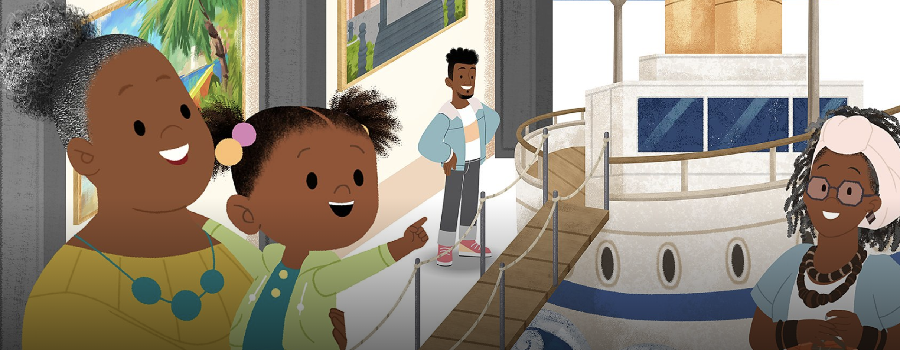


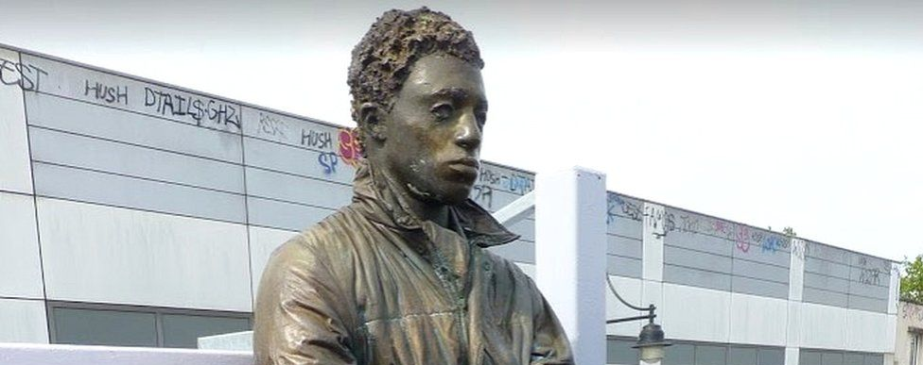
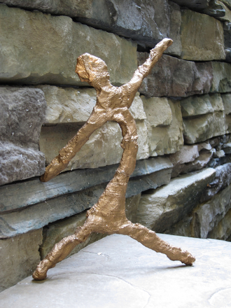
Year R
Focus: Objects from that past.
Curricula links: Understanding the World, History, British Values
Hook: JoJo & GranGran (Cbeebies). Episode: ‘It’s time to go on a voyage’ – The story of Gran Gran’s voyage from St. Lucia (Windrush). https://www.bbc.co.uk/iplayer/episode/m001crtf/jojo-gran-gran-series-2-autumn-1-its-time-to-go-on-a-voyage
Additional learning opportunities for EYFS:
Caribbean hairdressers role play – seek items from AfroCity (St. Mary’s Street). Braiding opportunities, empty products for styling, magazines depicting different styles. Toy heads for practising braiding.
Traditional costumes, traditional food tasting – create a scrapbook to share photos. Consider tropical fruit salad.
Bring in special ‘family’ items – similar to Gran Gran and her duffle coat.
Expected outcome:
Pupils will create a Kente pattern cloth as a group.
In groups, create a small Kente cloth/paper weaving.
Year 1
Focus: Statues
Curricula links: Geography, History, PSHE, British Values
Hook: BBC Video. (Context) The Life of Mary Seacole https://www.youtube.com/watch?v=uavk4N2Nk9s. Video: The unveiling of the Mary Seacole statue – the first statue of a black woman in the UK: https://www.youtube.com/watch?v=sJR7JGGKbmc
Additional learning opportunities for Year 1:
Discover the lives of significant black individuals from the past who have contributed to national and international achievements.
Consider Black Britons connected to Southampton – Windrush arrivals
Understand the purpose of statues across Britain – help children to understand that fewer than 10% of all statues in the UK depict a person of black heritage. Why isn’t this fair? What does this say about peoples attitudes?
Expected outcome:
Use drawing, painting and sculpture to develop and share their ideas, experiences and imagination.
Pupils will create tin-foil statues of a chosen person of Black Heritage studied.
https://www.education.com/activity/article/how-to-make-a-sculpture/
Pupils will create display labels for their statue.

Slide 4
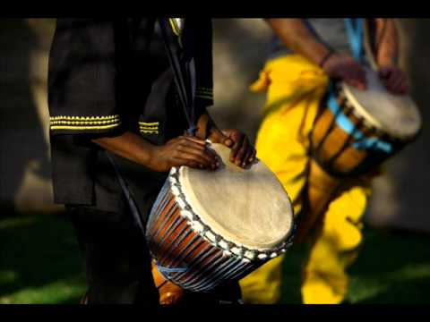
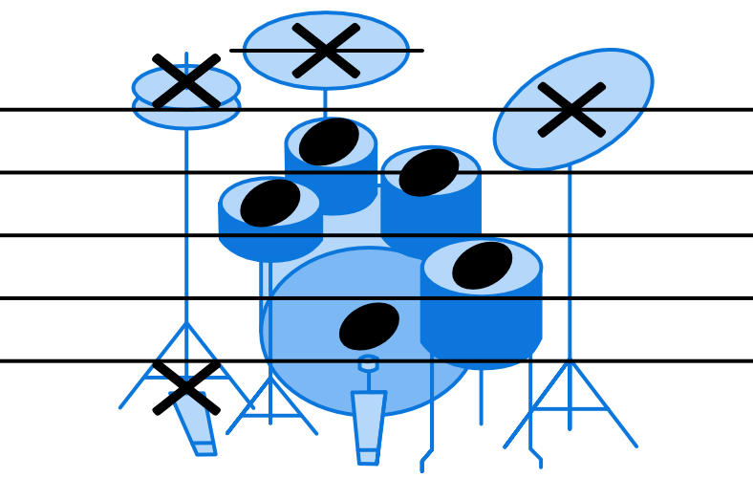
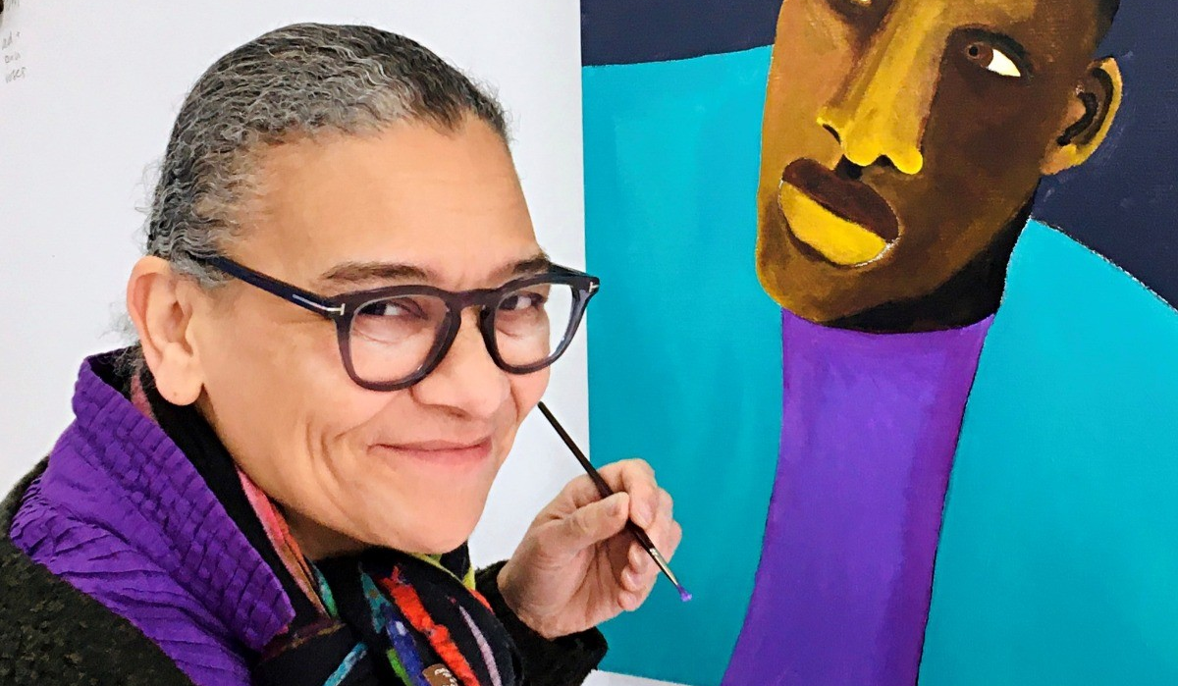
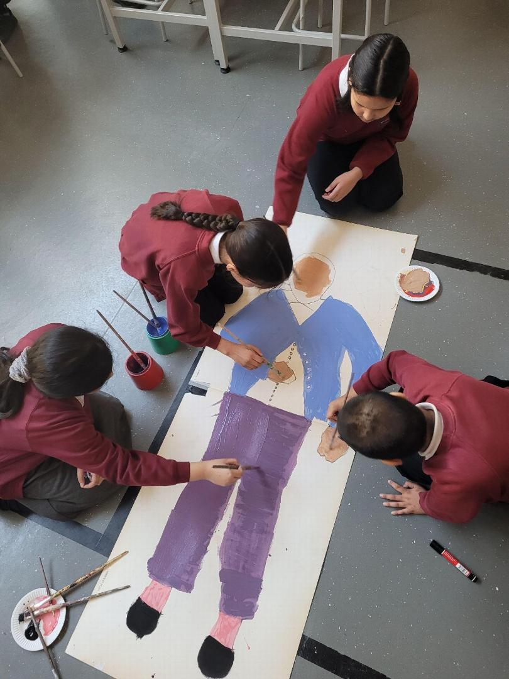
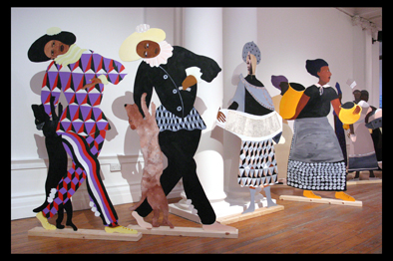
Year 2
Focus: Celebrating the music of Black History
Curricula links: History, Music, PSHE, British Values
Hook: ‘Say it Loud – I’m Black and I’m Proud’ – James Brown https://www.youtube.com/watch?v=9bJA6W9CqvE & The First Music (African Folktale) https://www.youtube.com/watch?v=EqGli-UrHPw
Additional learning opportunities for Year 2:
Djembe drumming – in the style of the ‘First Music’ African Folktale. Learning about how the instrument was made – primitive construction – not like mass-manufacture items today.
Breaking down – in Literacy – the lyrics to Say It Loud.
Understanding the civil rights movement in 1960’s Britain and Black African struggle for equality. Understanding that the song by James Brown would have been controversial.
Expected outcome:
Pupils will compose a piece of music – linked to Djembe drumming – to perform (and iPad record) to be played to parents in an assembly of their learning throughout the week. The musical score needs to be created using a symbol system the child decides.
Year 3
Focus: Black British artists and their impact
Curricula links: Art & Design, History and Literacy, British Values
Hook: Tate Gallery Intro into Lubaina Himid’s work. https://www.youtube.com/watch?v=L8-8eM7WJs0 – The first female Black British artist to feature an entire exhibition in one of the World’s most famous art galleries.
Additional learning opportunities for Year 3:
Contextualise Lubaina – her life coming to the UK: https://www.tate.org.uk/kids/explore/who-is/who-lubaina-himid
Literacy – narrative work – look at a few of her pieces. What story do they tell?
Why are some of her works cut out? – Explore her style.
Consider the artist’s journey to the UK from Zanzibar, Tanzania.
Expected outcome:
Create a piece of art-work – to be displayed permanently within the school.
Over the course of the week – pupils will begin to create a painting in her particular style – simplistic – depicting everyday black people.
This will progress to groups creating a large painting – similar to that of her most familiar piece ‘Naming the Money’.
Some pupils will create individual canvas paintings.

Slide 5
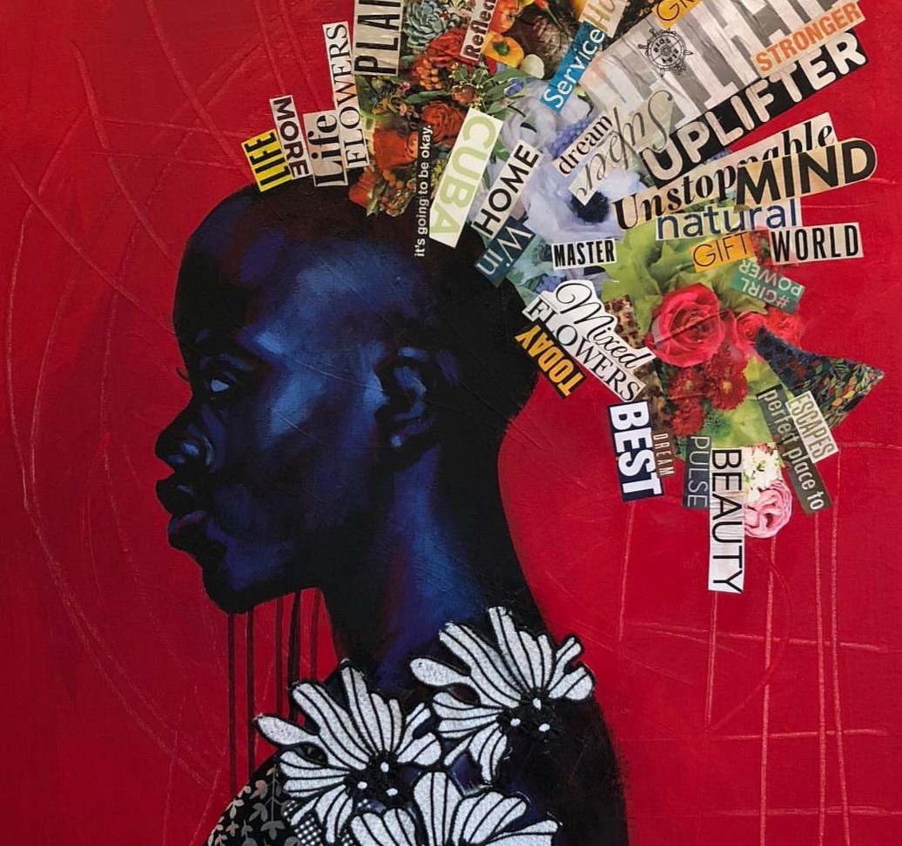
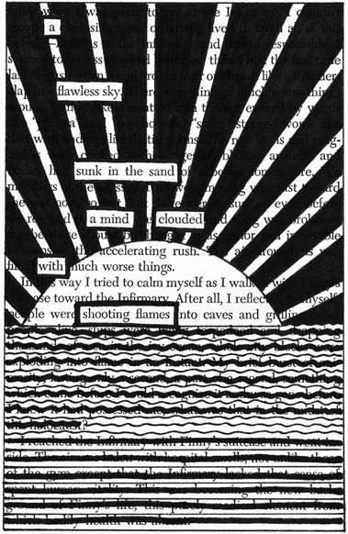
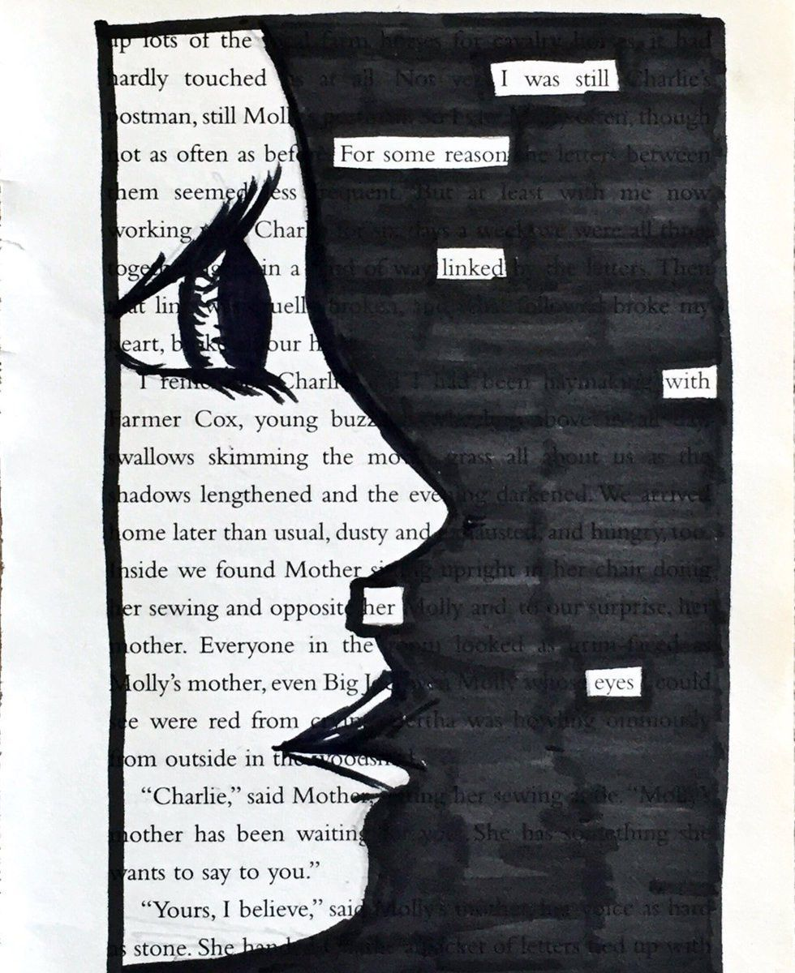
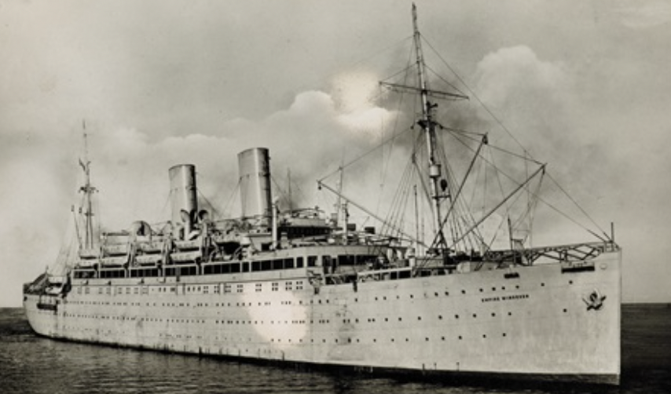

Year 4
Focus: The diversity of Poetry
Curricula links: Reading, Writing, Music, PSHE, History, British Values
Hook: ‘Caged Bird’ by Maya Angelou. https://www.youtube.com/watch?v=xrCoDi0BBdY. Compendium of Black History Month poetry: https://www.poetryfoundation.org/collections/101640/celebrating-black-history-month
Additional learning opportunities for Year 4:
Dadaist and Black Out Poetry – taking an old text and creating meaningful poetry by ‘black out’ of the surrounding text. These will be backed for a display of Poetry Art.
Understand the life works of Maya Angelou, her early life and struggles and how this became her focus: https://www.youtube.com/watch?v=IhJc1wcpSmA
Compare Maya to Grace Nichols – British poet https://www.bbc.co.uk/teach/school-radio/english-ks2-grace-nichols-talking-poetry/zf3y2sg
Look at talking poetry. How can we create poems that reflect the lives of people and their struggles.
Expected outcome:
Pupils will create a spoken poem – this will be crafted over the week.
Pupils will perform their poem in an assembly.
Poetry should reflect the theme of Black History – consider use of ‘The British’ poem Zephaniah https://www.poemhunter.com/poem/the-british/
Year 5
Focus: Journey to England - Storytelling
Curricula links: British Values, Writing, Reading, History and PSHE.
Hook: 1950s British Pathe footage of Windrush arrivals: https://www.youtube.com/watch?v=QDH4IBeZF-M&t=63s Windrush background: https://www.rmg.co.uk/stories/windrush-histories/story-of-windrush-ship. Historical context: https://www.youtube.com/watch?v=Si3IRAPJkkU Personal stories: https://www.youtube.com/watch?v=GamxNrkwqMw and https://www.youtube.com/watch?v=_UwLep9KEFk
Additional learning opportunities for Year 5:
Make tangible links to slavery – which is contained within the school’s History Pathway curriculum. (This is pre-teaching for the Summer)
Bring alive the issues of slavery – Sarah Forbes Bonetta – a girl captured during a slave hunt at 8 years and given to Queen Victoria as a present. Contextualise this.
Expected outcome:
Children to research and present narratives of those who came to England seeking a new life. Using archive footage and video – pupils are to write a ‘coming to England’ story from the perspective of a Windrush migrant.
Narratives should be presented authentically – incorporating the hopes and dreams of those leaving their ‘home land’ to set up a new life in Britain.
Narratives must chart the journey and their initial feeling upon landing in Britain.

Slide 6




Year 6
Focus: Does Black British history feature well enough in schools’ curriculum?
Curricula links: Computing, English – Writing & Reading, History, PSHE, British Values
Hook: BBC Docu Clip ‘The 1919 race riots’ https://www.youtube.com/watch?v=s6QouexT0WI will contextualise the time. Pupils are to explore the opening statement – ‘I got taught the names of Kings and Queens – but nothing about anybody who looked like me’. This quotation will become the basis of the podcast pupils will make in groups.
Additional learning opportunities for Year 6:
Marcus Rashford and the racists 2021 chanting at the World Cup: https://www.youtube.com/watch?v=P7LRDBeHfes
Encountering racism in the UK: https://www.bbc.co.uk/teach/class-clips-video/pshe-ks2-bullying-and-racism/z7tv8xs Can pupils see and recognise the bullying behaviour?
Why are museums in the UK returning stolen artefacts back to their original countries? Debate - https://www.bbc.co.uk/news/uk-england-london-62456366
Multicultural Britain today https://learnenglish.britishcouncil.org/general-english/video-series/word-on-the-street/notting-hill/multicultural-britain#:~:text=The%20United%20Kingdom%20is%20an,have%20come%20to%20live%20here. – a focus on the positives of a country which is one of the most diverse in the World. Consider: 2022 – Black cabinet ministers in high office of UK government; more local government councillors representative of their communities – London specifically.
Expected outcome:
Pupils will create a Podcast – a 10 minute max discussion – on the theme of Black History and whether or not if features prominently enough in St. Mary’s Curriculum.
To support this – pupils should be taught to build a balanced argument throughout the week with time to practise talking through the content. Lots of opportunity for agree/build on/challenge – as this will be needed in the discussion.

Slide 7



Outcomes
We expect teachers to utilise PPA the week before to resource and collate tasks for pupils to be completing throughout the week.
In core exercise books – we should see Literacy learning with direct links – for each ‘project’ there are links to additional learning. Explore these throughout the week. Find poetry, prose and non-fiction texts to engage and stimulate.
In Humanities – user banner headings to clearly demarcate that learning is dedicated to Black History Study.
Note: Maths – During this week you will use assessment data (from Aut 1 tests) to plan lessons to plug gaps in pupils’ knowledge and skills. Lessons should still include a bookmark – but be clearly linked to areas of concern. It is not necessary to make links to black history and maths.
There will be no independent write. However, you may create ‘published’ information/narrative pieces. These will not be required for marking against the Independent Write criteria.
Learning Intention & Success Criteria
Learning should still be progressive. Learning tasks should have LI and SCs to demonstrate to the pupil how and what they are learning.
Resourcing
Ensure that all video/information text content is reviewed by you and your team to be sure that the content is suitable for its audience. Visiting speakers must have content vetted before arrival to school and risk assessments undertaken.
We do not anticipate needing to spend money on resources – if they are needed – let DCP know.
Black History Study
Context: To understand the impact of the 1919 riots on the black community in Britain.

