Slide 1

Mason moor field of dreams
2024-2025
BE THE BEST VERSION OF YOURSELF!
#teammasonmoor

Slide 2
Mason Moor – Field of Dreams
At Mason Moor we want our children to have as many sporting opportunities as possible. We do this through PE, clubs, trips, tournaments and events.
Now we want to go one step further. We think ALL our children work extremely well when it comes to working as a team. It’s really nice to see children within the class/year groups work well together. But, we want this to happen across the school.
So, we are starting our very own #teammasonmoor Field of Dreams.
ALL children from year 1 – year 6 will have the opportunity to sign up for their chosen sport. The children will have dedicated time each week to take part in that sport.
Each sport will be taught and championed by a teacher within school. There will be a chance to win certificates and awards.

Slide 3
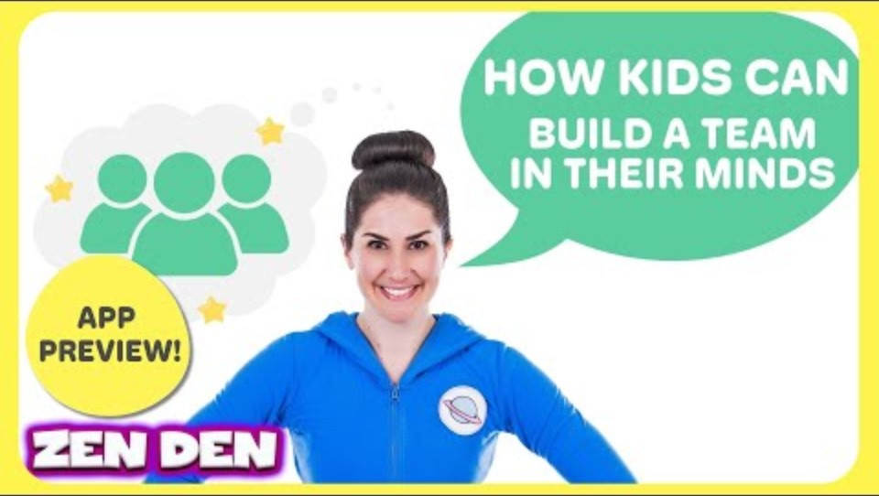
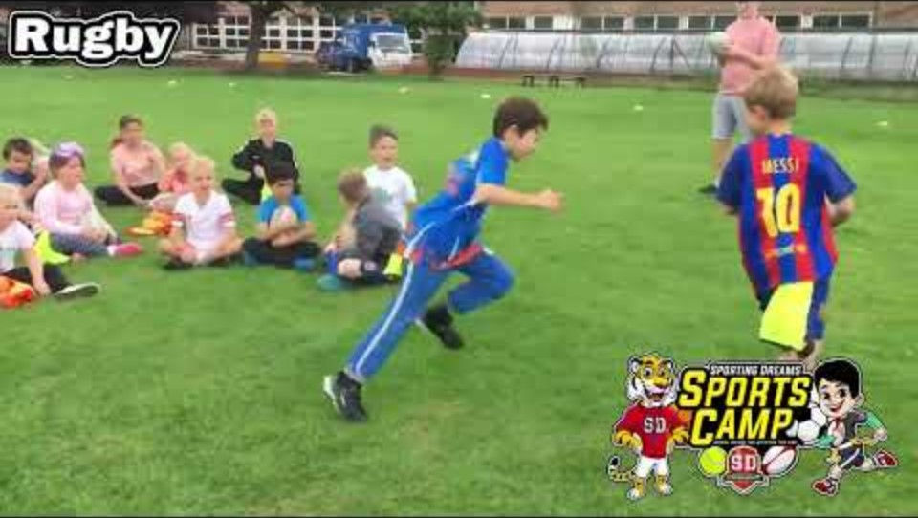
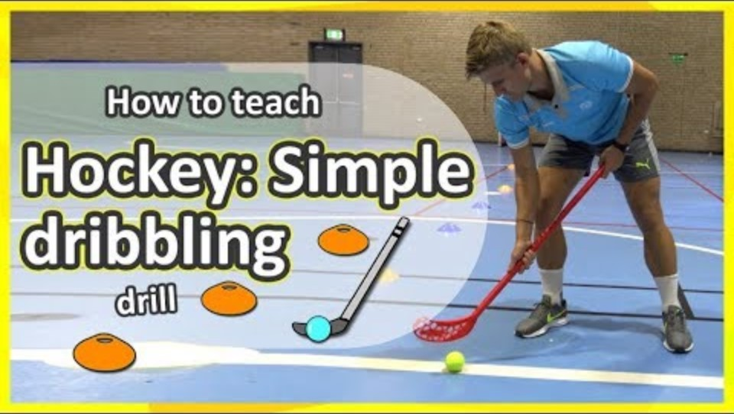
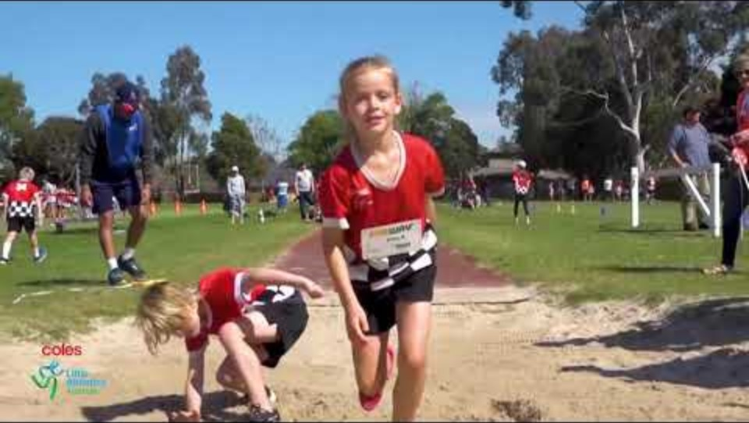
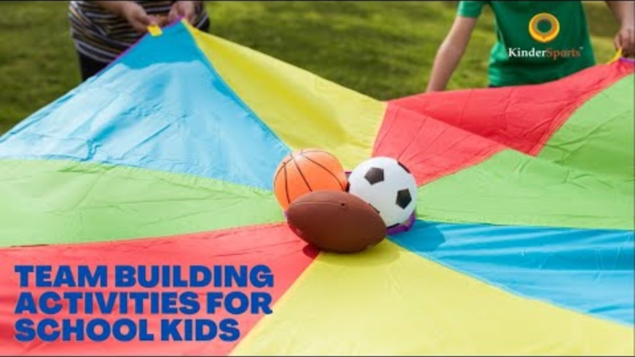
Field of Dreams – Sports on offer
Ms Adie – Yoga/mindfulness
Mr Bauck –
GoLF
Mr Sharman –
Tag Rugby
Ms Bidgood –
Dance
Ms Birkett –
Hockey
Ms Jablonska – Athletics
Ms Cox & Ms DAY –
Tennis
Mr Hassan –
Team building games

Slide 4
Field of Dreams – Sports on offer
Nexts steps…..
Your teacher has a register and will ask you which sport you would like to sign up to.
You will need to pick a first and second choice.
Mr Bauck will collect the registers and organise the children into activity groups. You may not get your first choice however we will try our best.
After Christmas the field of dreams sessions will start Mondays - 9.00-10.00am
Just a few reminders……..
Field of dreams is all about supporting each other and working as a team.
Showing respect to all.
Learning anew skill and most importantly having FUN!
#TEAMMASONMOOR

